Slide 1

"Womenomics" & Gender-Inclusive Software:
What the Software Industry Needs to Know
  Margaret Burnett
  Oregon State University
  October 2016
  #gendermag
Notes:
Same as India keynote except for the ACM slides.
Thank you for coming. I’m delighted to have this opportunity to talk to you about something that’s been a passion of mine for over a decade now: women & software itself. (not in the workplace…)
This needs to fit in 45 minutes. Sometimes this goes almost an hour (& that’s if I don’t allow intermittent questions).
To do this, don’t blather a lot during the intro.

Slide 2




Introduction
Q: Does software …
  support a variety of smart users?
A: No.
  Unconscious bias, supporting (mainly) 1 kind of user.
Raise awareness of (unconscious) bias in software:
  Concretely via GenderMag (beta):
  to find gender inclusiveness issues in software.
Notes:
I have years of data that suggests No.
Raise awareness of (unconscious bias) in software environments that don’t promote plurality”

Slide 3
How to solve??
  “We want your $. Here’s a surface gesture to show that we’re not thinking about you”
Shrink it and Pink it is not a strategy
  Dell’s pink laptops (2009)
  BIC for her
If you’re a man:
  Research/listen to women as a foreign market.
  People grow up within the culture of their gender.
  Within-gender: more different than alike.
So… needs to be about inclusiveness
  Not about “typical” females or males
  To help products get there: GenderMag
  If you’re a woman,
  If you’re a non-traditional gender,
Notes:
Dell story is from [Harvard 2009].
Man: cultural differences

Slide 4




The GenderMag Method
Abby (Abigail)
Tim (Timothy)
Gender Inclusiveness Magnifier
  Evaluates tools’ inclusiveness
  Scope: problem-solving
GenderMag has:
  Personas: 5 gender inclusiveness facets
  Gender-specialized CW:
    embeds facets & personas
    into a process
Pat (Patrick & Patricia)
Notes:
GenderMag is a method, but it’s also a concrete way to understand the issues.
So I’m using it as my vehicle to talk about this line of research.
Pause: programming environments, debugging systems, software vis, …

Slide 5

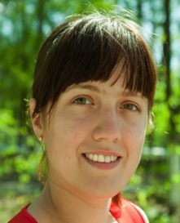
GenderMag’s 5 facets +
Abby/Tim/Pats
GenderMag Personas:
  ”representatives" of a range of users, but only…
…from the perspective of 5 facets:
  Motivations
  Information processing style
  Computer self-efficacy
  Risk averseness
  Tech learning style (tinkering)
Tim (Timothy)
Abby (Abigail)
Pat (Patrick & Patricia)

Slide 6

abby
Notes:
Here’s Abby. For now, just notice that:
* she fits on 1 page
* the key points have bullets
* the top (above the line) doesn’t matter
* she can look like any of these people: mainstream Abby, younger, different ethnic Abby, older, well-off Abby, male, different ethnic, could have any income level Abby
* We’ll let Abby introduce the 5 facets to you.

Slide 7
abby-Self-Efficacy
Facet #1
… comfortable with technology she uses regularly, but…
Computer Self-Efficacy: Abby has low confidence about doing unfamiliar computing tasks … and she often blames herself for problems …
…
Notes:
Should be 9-10 minutes in when I get here.

Slide 8


Computer self-efficacy [Bandura]
A form of self-confidence:
  W.r.t. a specific task.
  A general theory.
Predictive of:
  Willingness to try,
  perseverance, …
Literature:
  Females lower computer self-efficacy than their male peers [Beckwith, Burnett, Hartzell …]
Notes:
and, Hartzell CACM’03, Margolis/Fisher ’03

Slide 9
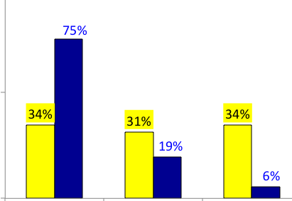




Computer self-efficacy data & the personas
High
Medium
Low

Slide 10

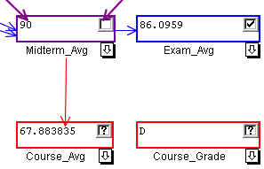
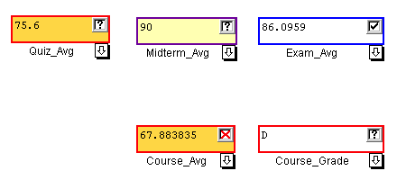

Features + self-efficacy [Beckwith]
Type familiar: formula edits.
Type taught: √, ->.
Type untaught: X.
Notes:
The first feature is formula edits – since users were coming in with spreadsheet experience we considered this “feature” a familiar feature, one they have used before.

Slide 11

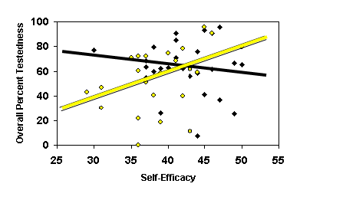



Confidence and features [Beckwith]
Self-efficacy as a predictor of effective use:
  F lower computer self-efficacy than M.
  F: self-efficacy mattered to willingness to use
  new features. (Not so for M).

Slide 12
Interest in new features
Try the features?
  Time to first usage:
Use the features?
  Genuine engagement:
Usage counts | Familiar | Taught
Males | 24 | 123
Females | 30 | 88
Time-
to-first
People counts | Untaught Not Used by... | Untaught Used by...
Males | 5 | 22
Females | 13 | 11
Fam.
T.
UnT.
Notes:
Measured 3 diff ways, always got the same answer

Slide 13
Their goal:
Find and fix bugs
Bug counts | Seeded Bugs Fixed | New Bugs Introduced
Males | 6 | .1
Females | 6 | .6
No difference
Difference
Notes:
Another measure of effectiveness is fixing the bugs.
Between the two tasks there were 10 bugs to fix. Overall the males and females fixed about the same number of bugs. However, looking at how many bugs were introduced (on cells that did not have bugs to begin with) – and were still remaining at the end of the task the females left significantly more bugs at the end of the task.

Slide 14
Pausing our Story:
What Changes Can We Make?

Slide 15
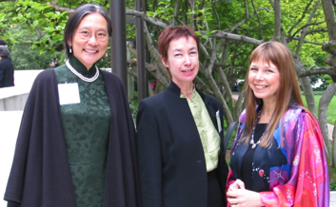
Changes that can reduce barriers
Empirical evidence suggests ways to make tools more effective for M and F.
Here are three such ways:
  1. Nuanced judgments.
  2. Addictive tinkering dissuaders.
  3. Strategy/process help.
Notes:
Others are wizards, non-violent language, supporting comprehensive info processing, todo listing, Tan/Czerwinski “visual flow” guides, …

Slide 16



1. Nuanced judgments
(revealed by F)
When asking for judgments, eg on correctness.
  Before:
  The change:
  The effect:
    Significantly reduced differences in how males vs. females utilized the tools.
    Everyone used them, helped both M and F.
Left-click

Slide 17
And Now,
Back to Abby and the Facets

Slide 18
abby: risk
Facet #2
…
Attitude toward Risk: Abby rarely has spare time. So she is risk averse about using unfamiliar technologies that might need her to spend extra time on them….
…

Slide 19
Risk
Notes:
The distribs are very different,

Slide 20

F: Risk Aversion + Low SE ->
A self-fulfilling prophecy
F’s statistically more risk-averse than M [Weber].
F’s: statistically lower self-efficacy
  F’s self-efficacy -> feature usage (but not M).
F less likely to accept features
  Opinion: too long to learn (RISK)
  But: no difference in learning!
Using features safest!
  Formula edits = only way to add new bugs
    so laws of probability -> add bugs.

Slide 21
Abby: tinkering/ways of learning tech
Facet #3
…
….
Learning: by Process vs. by Tinkering: Abby leans toward process-oriented learning, e.g. ... step-by-step processes, … how-to videos, etc. She doesn't particularly like learning by tinkering with software.

Slide 22




Tech Learning: by Tinkering?
[Beckwith, Burnett]
Females’ tinkering to learn:
    Tinkered less.
    Prefer other ways of learning tech.
Tinkering “pausefully”
    But when F did tinker, was “pauseful”.
    Education literature: pauses improve critical thinking
    Our results: pauses predictive of …
      Understanding
      Effective use of these features
  Males:
    Tinkered more.
    Sometimes pauseful too…
    but sometimes went crazy.
      When went crazy, it hurt.
Females
Males
Notes:
Graph is amount of tinkering (low cost environment).

Slide 23
Pausing our Story Again:
What Changes? (cont.)

Slide 24
Changes that can reduce barriers
Empirical evidence suggests ways to make tools more effective for M and F.
Here are three such ways:
  1. Nuanced judgments.
  2. Addictive tinkering dissuaders.
  3. Strategy/process help.
Notes:
Others are wizards, non-violent language, supporting comprehensive info processing, todo listing, Tan/Czerwinski “visual flow” guides, …

Slide 25
2. Addictive tinkering dissuaders (revealed by M)
When problem-solving, don’t want addictive tinkering.
To solve, make cost of a tinker a little higher.
Before: 1 click:
After: 2 clicks:
Effect:
  Stopped M excessive tinkers, didn’t hurt F.
click
click
click

Slide 26
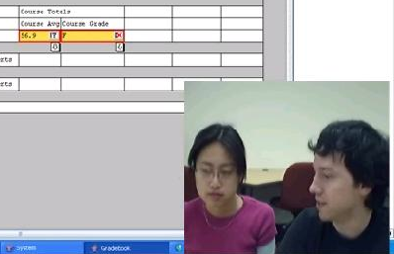
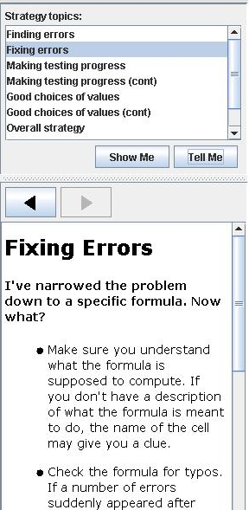
3. Strategy/process
“Active users”
  A prior study:
    30% of what M/F wanted was strategy info.
    >2x as many statements as for features.
  Before: help on features.
  The change:
    1-minute video snippets
    ...and equivalent hypertext...
    integrating features with strategy/process.
  The effect:
    F used more features,
    Everyone liked system better.

Slide 27
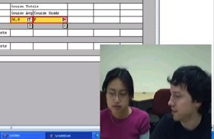
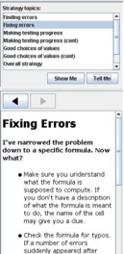
One Set of Lab Results:
M/F Differences in Self-Efficacy
TF vs. CF: Self-efficacy decreased less.
TF vs. CF: Judged their performance more accurately (Bugs Fixed better predictor of Post SE).
Triangulated with post-session
questionnaire answers.

Slide 28
Returning to Abby and the Facets…

Slide 29
abby: info processing
Facet #4
….
Information Processing Style: … comprehensive… gathers information comprehensively to try to form a complete understanding of the problem before trying to solve it.

Slide 30


Information Processing
Comprehensive vs. Selective [Meyers-Levy]
  “Everything first” vs. “Depth first”
  In batches vs. Highly incremental
  Here’s what it looked like in a sensemaking study…

Slide 31
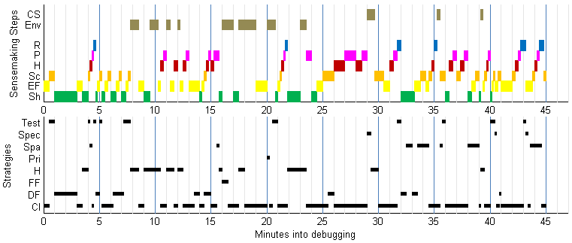
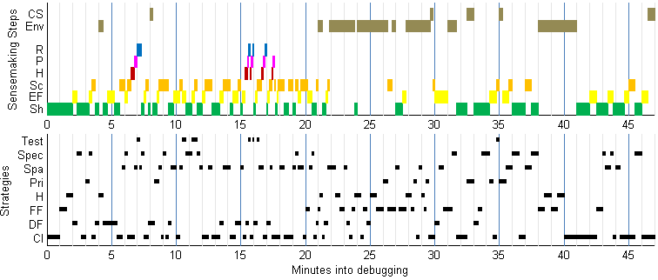
Information Processing [Grigoreanu]
Example (M top, F bottom):
Notes:
This came from Val’s spreadsheet study. This one was in Excel, whereas [Subrahmaniyan CHI’08] was in Forms/3.
+=find, *=fix. Hollow=wrong fix.
(Black) Successful M: max info-gather was 5 minutes. Mostly about 2 before he climbs up.
(red) And look how many mistakes he made (hollow stars) along the way.
Finally fixed abt the same number as the F.
Successful F: Max info-gather was 18 min. At least 5 between limb “batches”

Slide 32
Pausing Again:
Changes (cont.)

Slide 33

Lab Results: Attitudes to Info
All (+)
Information (+)
Notes:
(click): gender gap attitudes : treatment grp pretty much elim’d it (click)): and F absolutely loved the extra info.
(click): the females definitely benefited . (click) AND so did the males

Slide 34
Back to Abby

Slide 35
abby: motivations
Facet #5
Motivations:
… to accomplish her tasks. She learns new technologies if & when she needs to, but prefers … methods she is already familiar and comfortable with, to keep her focus on the tasks …
Notes:
Be <=23 minutes in!
(else skip Motivation to catch up).

Slide 36

Looked like this for one of our Fs…
“… So 0 to 100 [is the guard I’m entering], ok.
Ok, hmm…
So, it doesn’t like the -5 [...]. They can get a 0,
which gets rid of the angry red circle.”
Notes:
Talk about what guards are
Compare this female’s interest in the guards with the males in the following quote.

Slide 37

And like this for one of our Ms
“The first thing I’m going to do is go through and
check the guards for everything, just to make sure
none of the entered values are above or below any
of the ranges specified. So, homework 1—actually,
I’m going to put guards on everything because I
feel like it. I don’t even know if this is really
necessary, but it’s fun.”
(continuing from above):
“…ok, so it doesn’t like my guard apparently. Ok, ah ha!
The reason I couldn’t get the guard for the sum to be
correct is because the sum formula is wrong.”
Notes:
Notice with this male, the reason he starts to use the guards is because “it’s fun” – whereas the female was focused on the guard more in relation to her spreadsheet.

Slide 38
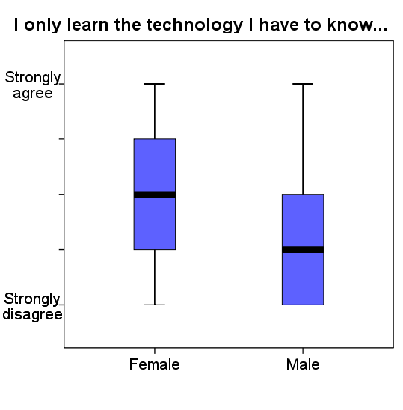
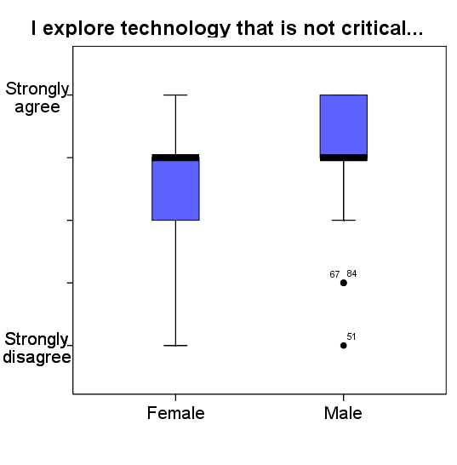
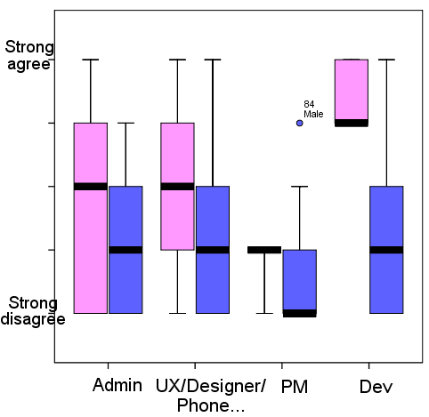
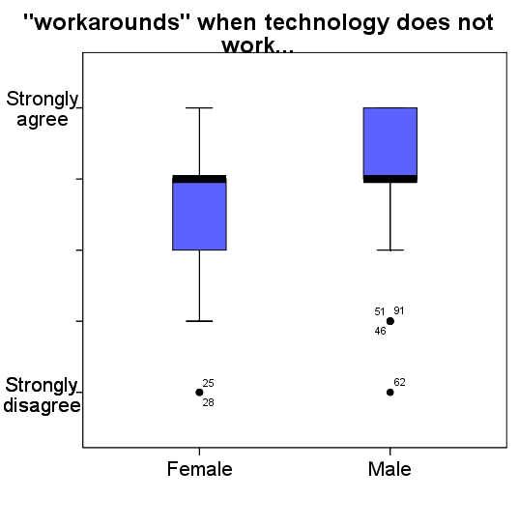
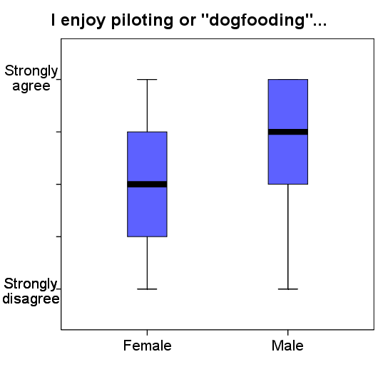
Across Populations [Burnett]
Stay with familiar features:
Fiddle with new ones:
pink
Notes:
This was the IT-Web study (ESEM’10)
Users said the same thing so-o-o many ways in these data.
This one is a combo w Tinkering .

Slide 39
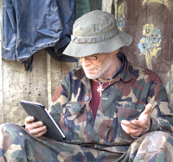


The rest of Abby
(mostly same as Tim & the Pats)
Background knowledge and skills
… an accountant … their software systems are new to her. … describes herself as a “numbers person”.
… degree in accounting … knows plenty of Math … knows how to think in terms of numbers. … never taken any computer programming or IT classes.
  … likes working with numbers in her free time … likes Sudoku and other puzzle games.
Notes:
Skippable – background changeable, identical.
This one is set up to show that they’re smart but definitely not programmers, to ward off “just like me” thinking.

Slide 40
GenderMag Cognitive Walkthrough
Standard CW: evaluates usability & learnability for a first-time user.
  Set-Up Phase:
    Decide on scenario and a path thru it.
  Analysis Phase: For each “ideal” action:
    Use prototype to step through the "ideal" path, answering specific questions along the way.
GenderMag CW: integrated reminders to the relevant persona facets, like this ➔

Slide 41
GenderMag CW
Each subgoal: Will have formed this sub-goal…?
    Yes/no. Why?
Each action:
  1. Will know what to do?
    Yes/no. Why?
  2. If action … will see progress to subgoal?
    Yes/no. Why?
Abby
/maybe.
Consider Abby’s Motivations…
Abby
/maybe.
Consider Abby’s , … Tinkering
Abby
/maybe.
Consider Abby’s Self-Efficacy & …
  …disinclined to push and poke…
Notes:
SB <=34 minutes in

Slide 42
Does it work? Empirical Overview
From:
  Formative case study at Company X [IwC’16]
  Formative Workshop Event at VLHCC’13 [IwC’16]
  Lab Study with UX practitioners in London [IwC’16]
  Field study (4 real-world software teams) [CHI’16]
  Working with several companies
  with Microsoft in the lead
Results:
  People: Usable by UX’ers, developers, etc. [CHI’16, VLHCC’16]
  Products: Makes them better! [IwC’16 + unpublished]

Slide 43
GenderMag in the Real World:
Field Study
Agency G: GB, GS | Company E | Company W
M+F devs & mgrs | M devs | M+F devs & UX
Abby | Abby | Abby and Tim
Travel | Machine learning | Mobile app
10 yrs old | Pre-release | Post-release & re-design
For operators | For developers | For smart phone users
Notes:
To evaluate GenderMag’s effectiveness in the hands of software practitioners developing real software projects, we conducted a multiple-case field investigation

Slide 44
Results: Inclusiveness Issues
Inclusiveness issues: due to facet values.
  — Enter <tag>
  — On the map, click <place>
  How would <Abby> know…? She prefers ... step-by-step.
  She doesn’t like to tinker, ... she’s risk-<averse>.
Notes:
* these software practitioners: surprisingly high number of gender-inclusiveness issues: 25% of the software features they evaluated had gender-inclusiveness issues. That’s 1 out of 4, in their OWN SOFTWARE.
* Say what’s an inclusiveness issue.
* Also found 30% more issues not tied to incluseiveness. Example:
View ranked list. WHY: Might not notice this option.
* A lot of rich results.
We have time to touch on only a few of the interesting bits: starting with Agency G.

Slide 45
Update:
Actually, it’s worse than 25%…
Latest average: 32%

Slide 46
Agency G: How’d it go?
GB: at first, ho hum...
  Then they relayed to the boss…
GS: Very excited.
Good use of facets.
Facets vs. Gender:
  They get it!
  I’ve seen this!
  …wasn’t necessarily about the gender… it’s <facet values>.
Notes:
Convinced because boss had actually seen that.
… as did all teams!

Slide 47

E: Utility & Follow-Through
  …about gender, or is it ... people differences?
  …makes it easy to detect those things.
Diversity is key.
Revealed things they hadn’t ever noticed.
2 weeks later…
  Had fixed 3 of the issues they found.

Slide 48


Company W’s Follow-Up
After a few weeks:
  Didn’t “own” the features, hard to convince others.
    But Team W believed,
    & persisted…
    … and got the important issues fixed!
After 5 months:
  Spin-off groups and related labs using.
After 10 months:
  Exploring wide, long-term usage.
  “Abby” lives on in the <x> lab.

Slide 49




So, promising results, but much to do…
Gender inclusive software rests …
  Not on “gender bucketing”,
  Rather on supporting diverse ways of
  thinking & problem-solving.
  One gender at a time.
  Download. Try it. Talk to me.
Women in tech do not generally need extra help, but the <software> in which they work does need help.
-facet-
Let’s change the world!
Notes:
much to do…
... to help the software industry (& the world) understand that ...
I really like this quote by Ashcraft & Dubow:

Slide 50
Q: Are these issues real? A: Yes.
13/14 issue types validated (97% of instances).
10 gender-verified (81% of instances).
  49% issues mostly aligned with 1 gender (M or F).
8 so important already had fixes in the works
  before the interview.
F’s like Gidget: 47% of its users are female!
Issue type | Abby | Tim | Real? | Gender? | Fixed?
Don’t want to try it | 24% | 12% | ✓ | F✓ | Want to, but not yet.
Fault localization | 16% | 16% | ✓ | M=F✓ | Fixed
Which feature? | 14% | 9% | ✓ | ? | Fixed
Assertions | 5% | 0% | ✓ | F✓ | Fixed
…
Notes:
Gidget lab results

Slide 51




Follow-ups & Resources
@GenderMag, #GenderMag
gendermag.method
Resources: gendermag.org
  Flyer, papers, personas, foundations, …
  Download the kit!
  Help make it happen @ your university/company!
  web.engr.oregonstate.edu/~burnett/
  Margaret.Burnett@oregonstate.edu
GenderMag

Slide 53
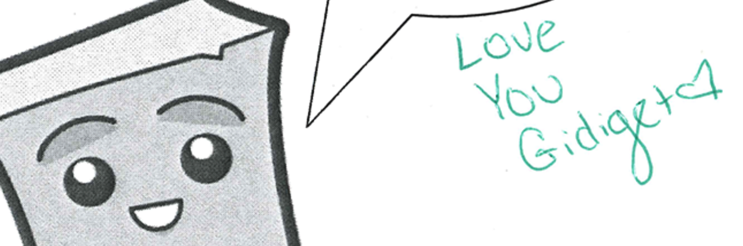
Leftovers

Slide 55

Motivation looked like this in “Clubhouse” [Margolis/Fisher]
One form of computing =
majoring in CS:
Notes:
% of M (blue) vs. F (red) who mentioned this factor as a reason.
The _only_ thing that’s remotely the same is “Enjoyment (of computing)”.
Figs 3.1 and 3.2 re-entered into a spreadsheet & redrawn as a radar graph.

Slide 56

And like this in “From Barbie…”
[Cassell/Jenkins]
From a study in which males and females fantasized about technology
Men | Women
Fantasize about it as a product | Fantasize about it as a medium
Want to use it for control | Want to use it for communication
Are impressed with its potential for power | Are impressed with its potential for creation
Ask it for speed | Ask it for flexibility
… | …

Slide 57
Information Processing
Comprehensive vs. Selective [Meyers-Levy]
  “Everything first” vs. “Depth first”
  E.g., (spreadsheets): Dataflow [Subrahmaniyan]
  Males followed dataflow > females (p<.04)
  Dataflow more helpful to M who used it than F who used it [Subrahmaniyan]
“Systematically go from the formulas that rely wholly on data cells, progressing to formulas that rely on other formula driven cells.”
Notes:
Figure 3 [Subrahmaniyan]: Correlation between total bugs fixed and number of dataflow instances. Left: male (significant), right: female.

Slide 58
Notes:
Agency G

Slide 59
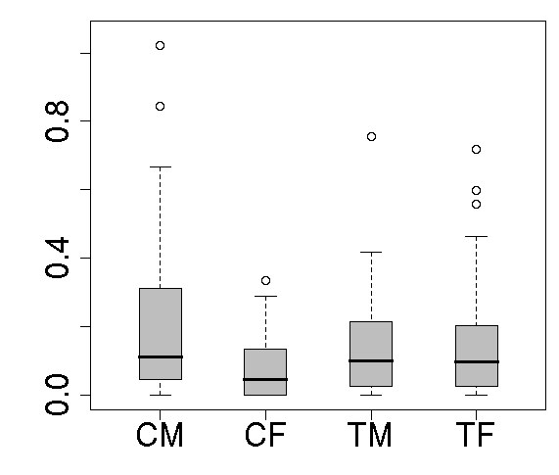
Lab Results: 3 changes together:
M/F Differences in Feature Usage
Gender differences in usage: gone.
Females: tinkering up.
Males: tinkering down.
Notes:
NOTE: prev study, M tinkered too much – here we fixed that. AND f tinkered too little before, and we fixed that too!

Slide 60
Lab Results (cont): Attitudes
All (+)
Information (+)
Notes:
(click): gender gap attitudes : treatment grp pretty much elim’d it (click)): and F absolutely loved the extra info.
(click): the females definitely benefited . (click) AND so did the males

